Slide 1


MG & DG STAKEHOLDER WORKSHOP 2024/25
Presented By: Mr PK NAICKER
GM: Skills Planning, Reporting & Research
FEBRUARY 2024

Slide 2



CONTENTS
SETA GRANT LEVY SPLIT
2023-2024 SUBMISSION STATUS
ANALYSIS OF SUBMISSIONS 2020 to 2023
SETA GRANT REGULATIONS
PIVOTAL – SPOI SECTORAL PRIORITY OCCUPATION AND INTERVENTIONS LIST

Slide 3



Slide 4
WSP/ATR PERFORMANCE OF THE FP&M SETA
WSP/ATR 2023-24
  WSP/ATR 2023-24 approved 1249, information outstanding 26, still on pre-application 3 = 1278
  WSP/ATR 2024-2025
  Levy Paying Companies as per data of October 2023 = 5442 (companies paying above R1000 is 4724 and those paying below is 718)
  A letter inviting 1282 companies who are not participating has been sent out through email. Specialist will be visiting companies in each region to address regional targets for
  ACCESSING SUPPORT OF ISSAs
    Need to make request on Company letterhead to the Skills Planning Department
    40 ISSAs contracted to support companies with mandatory grant submissions nationally
  SSP CAPACITY BUILDING WORKSHOPS
    Every Thursdays from 22nd February 2024
OUTPUT INDICATORS | 2022-23 | 2023-24
Total Number of WSPs and ATRs submitted | 1246 | 1278

Slide 5

2020 |  | 2021 |  | 2022 |  | 2023
Clothing | 106 | Clothing | 109 | Clothing | 152 | Clothing | 157
Dry Cleaning | 8 | Dry Cleaning | 7 | Dry Cleaning | 5 | Dry Cleaning | 4
Footwear | 41 | Footwear | 40 | Footwear | 40 | Footwear | 39
Forestry | 112 | Forestry | 116 | Forestry | 108 | Forestry | 122
Furniture | 85 | Furniture | 79 | Furniture | 73 | Furniture | 67
General Goods | 12 | General Goods | 10 | General Goods | 17 | General Goods | 17
Leather | 17 | Leather | 17 | Leather | 19 | Leather | 19
Other | 11 | Other | 8 | Other | 111 | Other | 122
Packaging | 109 | Packaging | 108 | Packaging | 123 | Packaging | 129
Print Media | 33 | Print Media | 33 | Print Media | 32 | Print Media | 34
Printing | 239 | Printing | 226 | Printing | 211 | Printing | 207
Publishing | 74 | Publishing | 72 | Publishing | 41 | Publishing | 48
Pulp and Paper | 36 | Pulp and Paper | 35 | Pulp and Paper | 36 | Pulp and Paper | 28
Textile | 335 | Textile | 337 | Textile | 195 | Textile | 200
Wood Products | 120 | Wood Products | 117 | Wood Products | 83 | Wood Products | 85
Grand Total | 1338 | Grand Total | 1314 | Grand Total | 1246 | Grand Total | 1278
ANALYSIS OF SECTOR SUBMISSIONS
FROM 2020 TO 2023

Slide 6
SIZE OF COMPANIES | TARGETS
Small Companies | 605
Medium Firms | 405
Large Firms | 345
Total | 1355
MANDATORY GRANT TARGETS 2024 – 25
Total of levy paying companies - 4724

Slide 7
SIZE OF COMPANIES | KZN | GAUTENG | WC
Small Firms | 300 | 300 | 200
Medium Firms | 200 | 200 | 150
Large Firms | 180 | 180 | 130
Total | 680 | 680 | 480
REGIONAL TARGETS

Slide 8
SETA GRANT REGULATIONS

Slide 9
Plan & Implement Training for their Employees
Create Training and Work Experience Opportunities for Unemployed People
Mandatory Grant Applications
Submission due by 30 April 2024
Enhanced SETA planning cycle
SSP Annual Update
Earlier Discretionary Funding Windows
Better alignment with skills development and financial year 2024/25
THE INTENTION OF MANDATORY
GRANTS IS TO INCENTIVISE
EMPLOYERS TO:

Slide 10
  Increased monitoring of WSP implementation against Board criteria
  Criteria for approval
  Evidence requirements
  Quality & accuracy standards for WSPs & ATRs
  Evidence of consultation and sign-off by labour representative (unless explanation is provided)
THE INTENTION OF MANDATORY
GRANTS IS TO INCENTIVISE
EMPLOYERS

Slide 11
A levy paying employer claiming a Mandatory Grant must
Meet the eligibility criteria for the payment of a Mandatory Grant
An eligible employer -
Has registered for skills development levies;
Has paid the levies in the prescribed manner and is up-to-date (minimum threshold R500k per annum);
Has submitted a WSP / PIVOTAL Plan and ATR/PIVOTAL Report within the prescribed timeframes (30 April) that contributes to the relevant SETA SSP
Has submitted an Annual Training Report and/or PIVOTAL Training Report, demonstrating some alignment to the previous year’s WSP and/or PIVOTAL Plan
WHO IS ELIGIBLE ?

Slide 12
The mandatory grant application consist of the following important sections:
  Organisational information
  Banking details
  Employment summary and Provincial Breakdown
  Provides information on the current workforce (including learners)
  Workplace Skills Plan
    PIVOTAL Plan
      Planned implementation of PIVOTAL learning programmes e.g. apprenticeships, learnerships, credit bearing skills programmes, work integrated learning, bursary programmes (post-school / tertiary qualifications at TVETs/ HEIs)
    Non-PIVOTAL Plan
      Planned implementation of other learning programmes e.g. non-credit bearing skills programmes, in-house training (health and safety, HIV/Aids awareness)
WORKPLACE SKILLS PLANNING

Slide 13
ATR and/or Pivotal Report must reflect all training conducted
  During April to March (of the previous financial year) 2023-2024
  Internally or Externally
  The WSP and/or Pivotal Plan must reflect all planned training
  Internally or Externally
  Planned for April to March (of the current financial year) 2024-2025
WORKPLACE SKILLS PLANNING

Slide 14
The WSP/ATR must be duly authorized and signed-off by:
  The Internal Training Committee / Skills Development Committee including designated labour representative
    Firms employing 50 or more employees; or
  The Owner / Chief Executive and designated employee representative
    Firms employing less than 50 employees
WORKPLACE SKILLS PLANNING

Slide 15
Deadline for submissions: on/or before 30 April
Applications to be submitted electronically via LMIS
Scanned authorization page and scanned current proof of banking details to be upload to LMIS Original proof of banking details will be required from first time applicants or if an applicant’s banking details have changed since the previous year’s submission.
Assistance will be supplied to applicants unable to access the LMIS on request
Requests for extension or anticipated delays to be submitted by 31 March 2024 for MG to Skills Planning Division
Subject to approval by Board
WORKPLACE SKILLS PLANNING

Slide 16
THE ORGANISING FRAMEWORK FOR OCCUPATIONS (OFO) GRANT REGULATIONS

Slide 17
SETAs/DHET use the OFO codes to develop and report on the Sectoral Priority Occupations Intervention (SPOI).
Employers to plan and develop their WSPs and ATRs.
QCTO as a basis for occupational qualification development and certification.
National Artisan Moderation Body (NAMB) for implementation of listed trades.
PSET system for development of qualifications and planning for the labour market.
Career Development Services uses the OFO for developing learning Pathways
WHO USES OFO?

Slide 18
OFO CODE STRUCTURE
GROUPS | CODE | DESCRIPTOR | OCCUPATIONAL CATEGORIES
1. Major Group | 1 Digit | The broadest level of the classification Differ based on skill level and the broadest concept of skill specialisation | 2 Professionals
2. Sub Major Group | 2 Digits | Sub-divisions of Major Groups Distinguished based on broadly stated skill specialisation | 24 Business and Administration Professionals
3. Minor Group | 3 Digits | Sub-divisions of Sub Major Groups Distinguished based on less broadly stated skill specialisation | 241 Finance Professionals
4. Unit Group | 4 Digits | Sub-divisions of the Minor Groups Distinguished based on a finer degree of skill specialisation | 2411 Accountants
5. Occupations | 5 Digits | Relates to a cluster of jobs which involve the performance of a common set of tasks. | 241101 General Accountant
6. Specialisations | 6 Digits | Skill specialisation is considered in terms of four conceptual concepts: • the field of knowledge required; • the tools and machinery used; • the materials worked on or with; and • the kinds of goods and services produced. | 241101 Bank Accountant 241102 Cost Accountant

Slide 19
ALIGNMENT OF OFO TO NQF AND SKILLS LEVEL

Slide 20
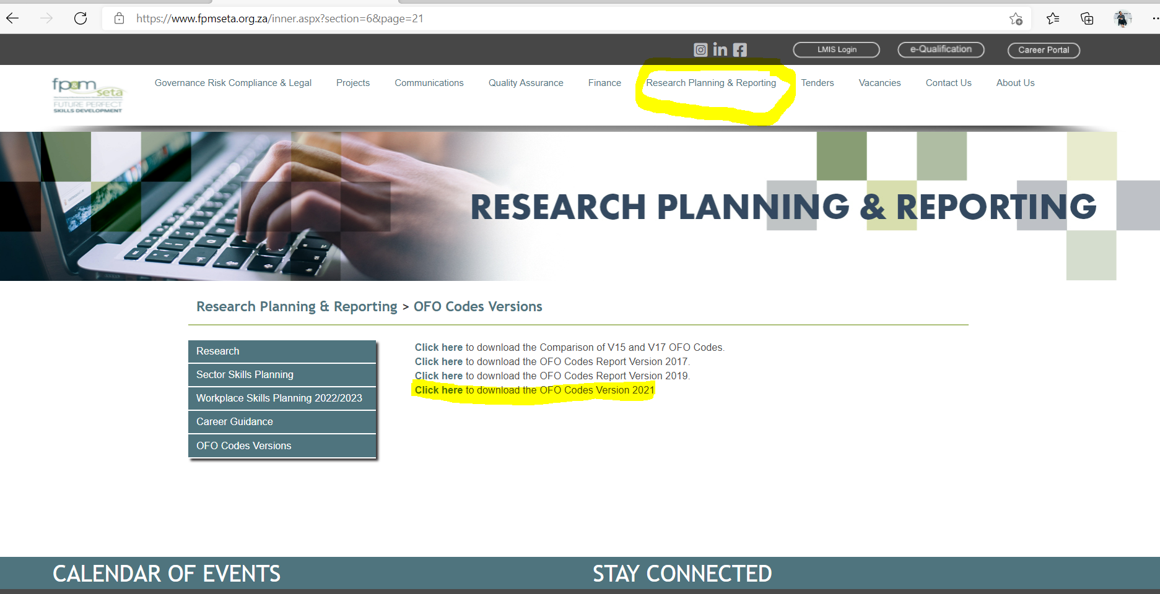
OFO CODES - VERSION 2021
ON FP&M SETA WEBSITE

Slide 21
Professional, Vocational, Technical and Academic Learning programmes that result in qualifications or part qualifications registered on the National Qualifications Framework (NQF) that address
- Sectoral Priority Occupations and Interventions which are:
Professional: Learning programmes shall mean programmes that lead to designations that are registered by professional bodies.
Vocational: Learning programmes shall mean noted and artisanal programmes that lead to a trade and/or the National Certificate Vocational (NCV).
Technical: Learning programmes shall mean programmes that are occupationally-directed and registered by the SETA; such programmes include apprenticeships, learnerships and skills programmes.
Academic learning programmes: Shall mean programmes that lead to academic qualifications such as certificates, Higher Certificates, Diplomas and Degrees.
PIVOTAL – SPOI SECTORAL –
PRIORITY
OCCUPATIONS AND
INTERVENTIONS LIST

Slide 22
An important step in compiling the Pivotal list is the vigorous analysis of the data received from all the 13 sub-sectors.
It thus envisaged that through the selected interventions the FP&M SETA can:
Research team ensures all the fields are fully and correctly completed by the companies,
The steps here include:
Verification
Correction
Accuracy checks and
Compilation of list
Address the (Occupations in high demand) needs across all its 13 sub-sectors
Address urgent skills gaps
To ensure the constant creation of a growing skills pool for the necessary professional and technical needs of its sub-sectors
Create pathways for new entrants through training programmes that lead to qualifications
THE ENVISAGED OUTCOMES FROM THE IDENTIFIED INTERVENTIONS

Slide 23
In the PIVOTAL/SPOI section of the WSP/ATR, companies are asked to complete information on the type of PIVOTAL/SPOI training.
Clarity on what PIVOTAL/SPOI is emphasized during MG/ DG workshops, focus groups and other stakeholder engagement sessions.
The fields here include the type and appropriate/ preferred intervention for the occupation, at a specific NQF level
IDENTIFYING
PIVOTAL/SPOI INTERVENTIONS

Slide 24
OCCUPATIONAL SHORTAGES AND SKILLS GAPS
OCCUPATIONAL SHORTAGES AND SKILLS GAPS | EXTENT AND NATURE OF SUPPLY | SPOI/PIVOTAL LIST
What occupations are HARD-TO-FILL VACANCIES? (It takes longer than 12 months to fill the position) How many of these occupations are HTFVs? Why are these occupations hard-to-fill? Reasons (are they skills-related HTFVs or non-skills related HTFVs?) What are the major SKILLS GAPS in your sector at the major occupational level? | What is the extent of occupational supply in the sector? What is the state of education and training provision? What supply problems are firms experiencing? | What methods did the SETA employ in identifying occupations in the SPOI/PIVOTAL list? (a small summary of the methodology) What informed the interventions indicated in the SETA /SPOI/PIVOTAL list? What are the envisaged outcomes from the identified interventions? What consultative processes did the SETA use to arrive at the occupations identified in the SPOI/PIVOTAL list? What are the main findings that informed the SPOI/PIVOTAL list? What informed the quantities indicated in the SETA SPOI/PIVOTAL list? Is the SETA SPOI/PIVOTAL list ranked, in order of priority? If so, what informed the ranking of occupations indicated in the SETA SPOI/PIVOTAL list?

Slide 25
REGIONAL OFFICES
HEAD OFFICE
General Manager SPRR: Mr. PK Naicker – 031 702 4482
Skills Planning Research and Reporting Manager
  Sylvia Tsunke – 011 403 1700
  sylviat@fpmseta.org.za
Skills Planning & Reporting Co-ordinator
  Sbahle Ndlovu– 011-403 1700
  sbahleN@fpmseta.org.za
Skills Planning Specialist
  Xoliswa Radebe– 011 – 403 1700
  xoliswaR@fpmseta.org.za
  Skills Planning Administrator
  Thulani Majola – 011 403-1700
  thulaniM@fpmseta.org.za
Johannesburg
  Pearl Ngiba–
  011-403 1700
  PearlN@fpmseta.org.za
Cape Town
  Xoliswa Radebe or below number for CT office
  021-462 0057
Durban
  Louise Sagar
  031-702 4482
  LouiseS@fpmseta.org.za
CONTACT DETAILS

Slide 26
THANK YOU
& QA

